Slide 1
STATISTICS FUNDAMENTALS, PART 2
Jonathan Landesman

Slide 2
LEARNING OBJECTIVES
STATISTICS FUNDAMENTALS, PART 2
Understand human limits on estimating probabilities
Causality vs Correlation and Luck
Practice using functions
Clean some data

Slide 3
TRY TO CONVINCE YOU OF:
STATISTICS FUNDAMENTALS, PART 2
The fact that people are generally poor at estimating probabilities
That it is incredibly difficult to determine causality - we might be seeing luck
Alternately the effect we see might be driven by something else
Validate your findings using statistical analysis (p-values, confidence intervals)

Slide 4
Probability
WE ARE ALL BAD AT PROBABILITY

Slide 5
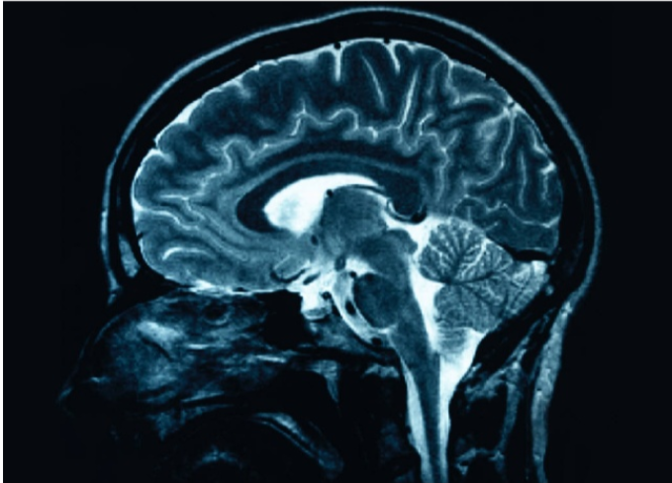
YOUR BRAIN
Source: ritholz.com

Slide 6

YOUR BRAIN ON PROBABILITY
Source: ritholz.com

Slide 7
THE LINDA QUESTION
Linda is 31 years old, single, outspoken, and very bright. She majored in philosophy. As a student, she was deeply concerned with issues of discrimination and social justice, and also participated in anti-nuclear demonstrations.
From this description, please rate in order which is more probable:
Linda is an elementary school teacher
Linda works in a bookstore and takes Yoga classes
Linda is active in the feminist movement
Linda is a bank teller
Linda is a member of the League of Women voters
Linda is a bank teller and is active in the feminist movement

Slide 8
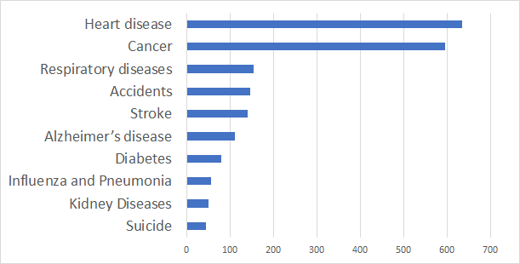
LEADING CAUSES OF DEATH, USA, 2015

Slide 9
EVEN MEDICAL TESTS ARE CONFUSING
Imagine a medical test that is 99% accurate.
Also imagine that 1 person in 1000 (0.1%) have the disease
Lets test 100,000 people:
Sick: 100 people are sick (0.1%) → 99 % accurate → 99 positive diagnoses
Healthy: 99,900 are healthy (99.9%) → 99% accurate → 999 FALSE POSITIVES (1% error rate)
Probability you are sick if the test says you are sick? 99/999 = 9%!

Slide 10
LUCK
WE ONLY SEE THE RESULT - AND THAT MIGHT BE LUCK

Slide 11

FOOLED BY RANDOMNESS
Not actually the actual consultant:

Slide 12

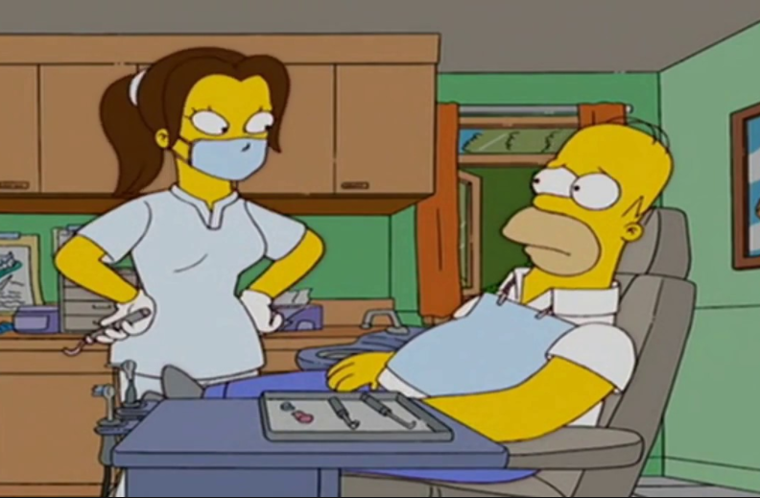
TRADER vs DENTIST and EXPECTED VALUE

Slide 13
CAUSATION VS CORRELATION
CAUSATION VS CORRELATION

Slide 14
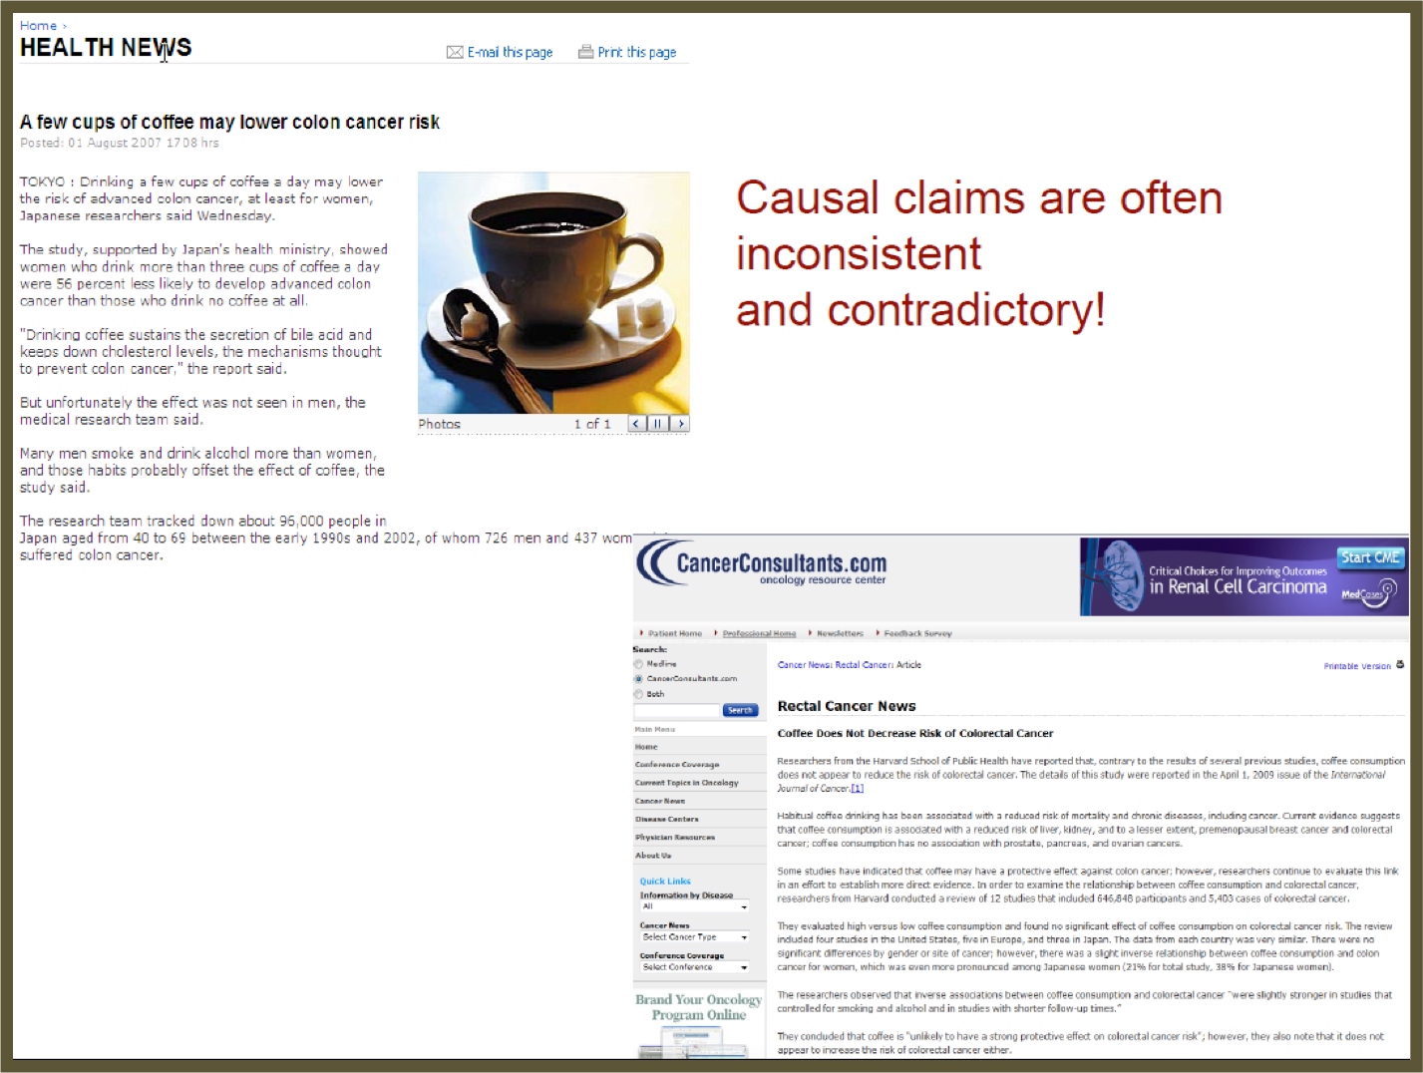

Slide 15
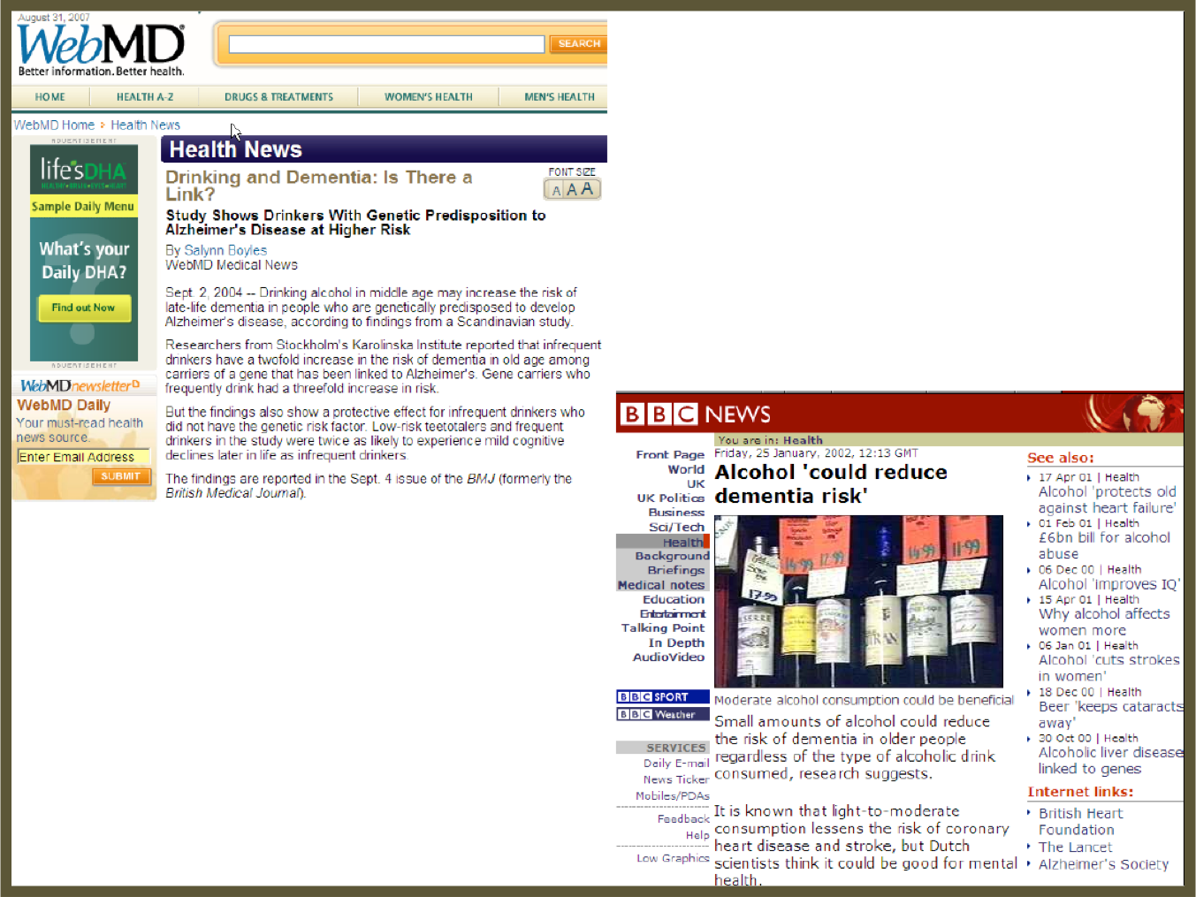

Slide 16
CAUSATION VS CORRELATION
THREE DRIVERS

Slide 17
DIRECTIONALITY
Imagine trying to estimate the effect of education on wealth:
WEALTH EDUCATION

Slide 18
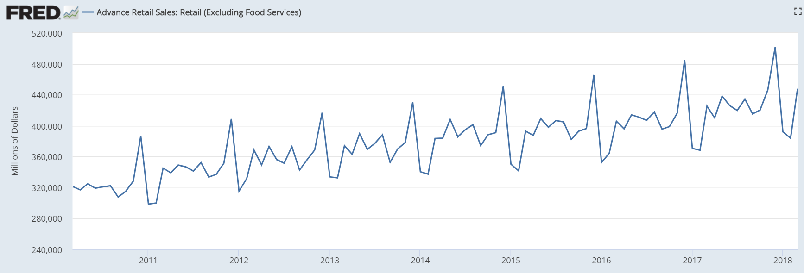
CONFOUNDERS
Imagine trying to estimate the effect of an advertising campaign in December

Slide 19
SHEER RANDOMNESS
http://www.tylervigen.com/spurious-correlations

Slide 20
INTRODUCTION
HYPOTHESIS TESTING

Slide 21
HYPOTHESIS TESTING
How can we tell the difference between two groups of observations (e.g. smokers vs. non-smokers)?
Imagine we are testing the health of smokers vs. non-smokers. At a cursory glance, our results may show that smokers are marginally healthier than non-smokers.
Are they healthier due to random chance or is there a statistically significant difference? Maybe we happened to assemble a strange group of smoking triathletes and a group of non-smoking couch potatoes.
This is where hypothesis testing can help.

Slide 22
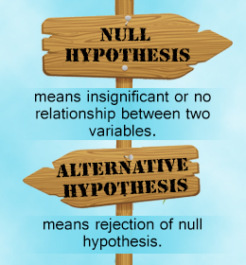
HYPOTHESIS TESTING STEPS
First, you need a hypothesis to test, referred to as the null hypothesis. The opposite of this would be the alternative hypothesis.

Slide 23
HYPOTHESIS TESTING STEPS
For example, if we want to test the relationship between gender and sales, we may have the following hypotheses.
Null hypothesis: There is no relationship between Gender and Sales.
Alternative hypothesis: There is a relationship between Gender and Sales.

Slide 24
HYPOTHESIS TESTING STEPS
Once you have your hypotheses, you can check whether the data supports rejecting the null hypothesis or failing to reject the hypothesis.
Note: Failing to reject the null is NOT the same as accepting the alternate. While the alternative hypothesis might be true, we don’t have enough data to support that claim specifically.
Keep this in mind so you don’t overstate your findings.

Slide 25
DEMO
HYPOTHESIS TESTING CASE STUDY

Slide 26
HYPOTHESIS TESTING CASE STUDY
We’re going to walk through Part 1 of the guided-demo-starter-code notebook in the class repo for lesson 4.
There are several questions to answer. We’ll answer those questions in small groups and then discuss with the class.

Slide 27

ACTIVITY: KNOWLEDGE CHECK
ANSWER THE FOLLOWING QUESTIONS
EXERCISE
What is the null hypothesis?
Why is this important to use?
DELIVERABLE
Answers to the above questions

Slide 28
INTRODUCTION
VALIDATE YOUR FINDINGS

Slide 29
VALIDATE YOUR FINDINGS
We know how to carry out a hypothesis test, but how do we tell if the association we found is statistically significant?
Statistical significance is the likelihood that a result or relationship is caused by something other than random chance.
Statistical hypothesis testing is traditionally employed to determine if a result is statistically significant or not.

Slide 30
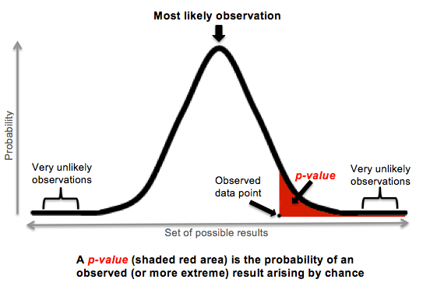
VALIDATE YOUR FINDINGS
Typically, a cut point of 5% is used. This means that we say something is statistically significant if there is a less than a 5% chance that our finding was due to random chance alone.

Slide 31
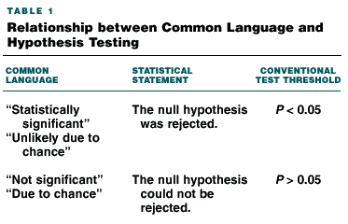
VALIDATE YOUR FINDINGS

Slide 32
VALIDATE YOUR FINDINGS
When we present results, we say we found something significant using this criteria.
We will use an example to dive further into this and understand p-values and confidence intervals.

Slide 33
DEMO
P-VALUES AND CONFIDENCE INTERVALS CASE STUDY

Slide 34
P-VALUES AND CONFIDENCE INTERVALS CASE STUDY
We’re now going to walk through Part 2 of the guided-demo-starter-code notebook in the class repo for lesson 4.
There are several questions to answer. We’ll answer those questions in small groups and then discuss with the class.

Slide 35
ACTIVITY: KNOWLEDGE CHECK
ANSWER THE FOLLOWING QUESTIONS
EXERCISE
What does a 95% confidence interval indicate?
DELIVERABLE
Answers to the above questions

Slide 36
INDEPENDENT PRACTICE
INTERPRETING RESULTS

Slide 37
ACTIVITY: INTERPRETING RESULTS
DIRECTIONS (35 minutes)
EXERCISE
Using the lab-start-code-4, you will look through a variety of analyses and interpret the findings.
You will be presented with a series of outputs and tables from a published analysis.
Read the outputs and determine if the findings are statistically significant or not.
DELIVERABLE
Answers to the questions in the notebook

Slide 38
CONCLUSION
LAB REVIEW

Slide 39
LAB REVIEW
Let’s review the answers to the questions in the labs.
Any other questions?

Slide 40
COURSE
BEFORE NEXT CLASS

Slide 41
DUE DATE
BEFORE NEXT CLASS
Project: Unit Project 2

Slide 42
LESSON
CREDITS

Slide 43
CITATIONS
THANKS FOR THE FOLLOWING
Title, Author: link
Title, Author: link
Title, Author: link

Slide 44
LESSON
Q & A

Slide 45
LESSON
EXIT TICKET
DON’T FORGET TO FILL OUT YOUR EXIT TICKET

Slide 46
THANKS!
NAME
Body Level One
Body Level Two
Body Level Three
Body Level Four
Body Level Five
Body Level One
Body Level Two
Body Level Three
Body Level Four
Body Level Five
Optional Information:
Email?
Website?
Twitter?

